Slide 1

Hyperparameter Optimization Module
Module Overview

Slide 2
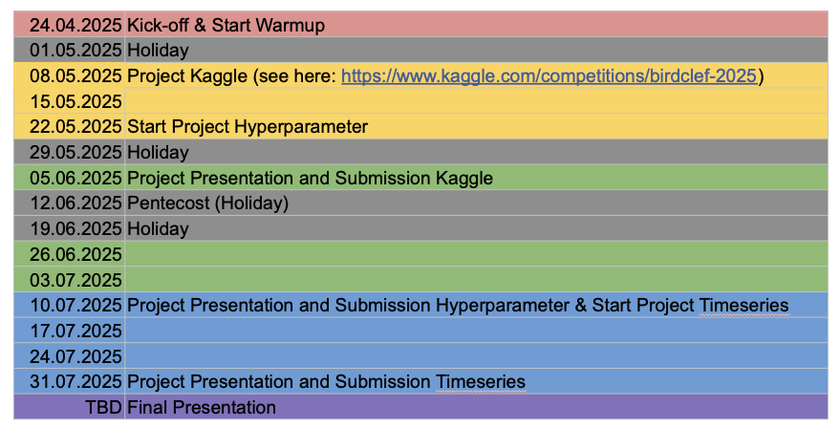

Slide 3
Overview
Motivation
Module Format
Categories
Libraries
Datasets
Evaluation Criteria
Tournament Notebook
Timeline
Choose your topic
Presentation
Balance Policy

Slide 4
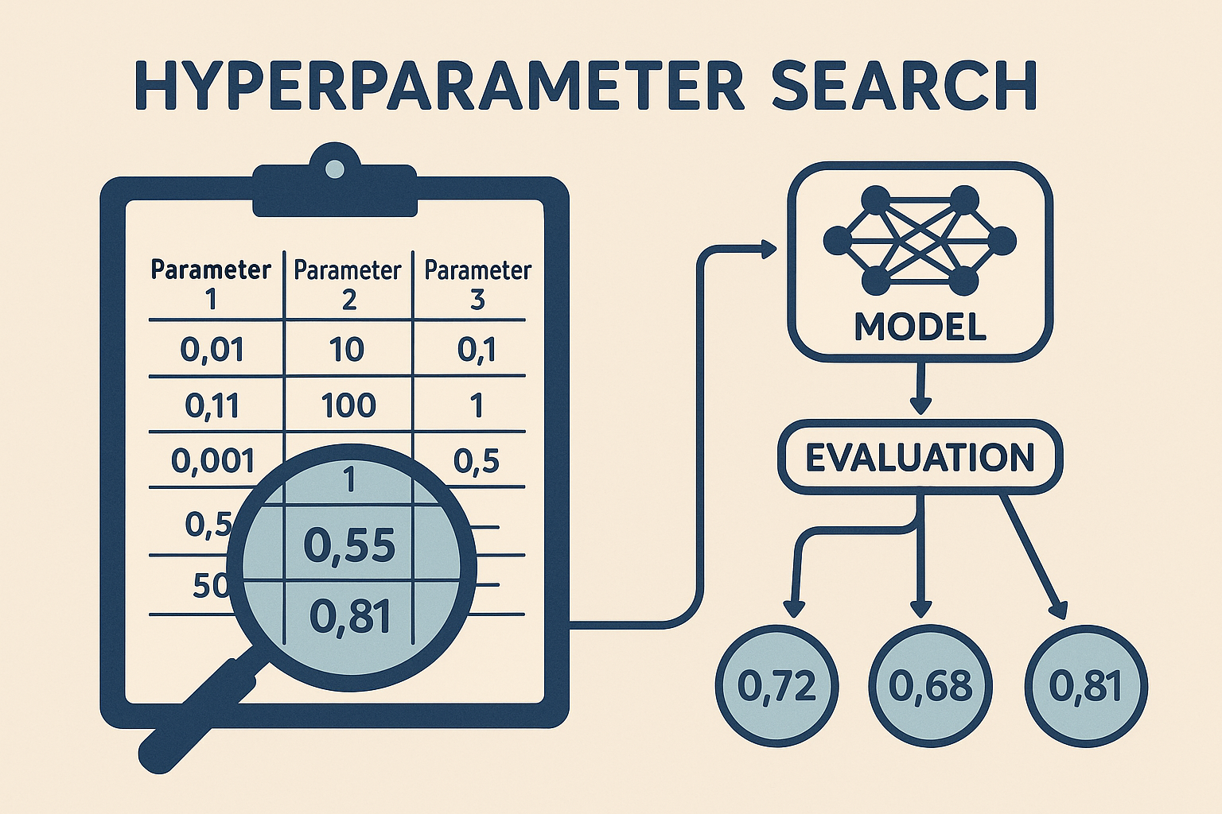
Motivation & Relevance
What is HPO?
A hyperparameter is a parameter that controls the training process and it must be set before training.
Research Relevance
Very active research area
Many different methods
From small to big
Setting a learning rate
Finding optimal HPOs for LLMs (like GPT or BERT)

Slide 5

Module Format
Duration: 5 weeks (4 meetings)
Each group explores 4 different HPO techniques (1 per person)
3+3+1 datasets
Output:
Data Analysis notebook
Tournament notebook
Presentation
Very detailed commented Code + Readme + requirements.txt (per Person)

Slide 6
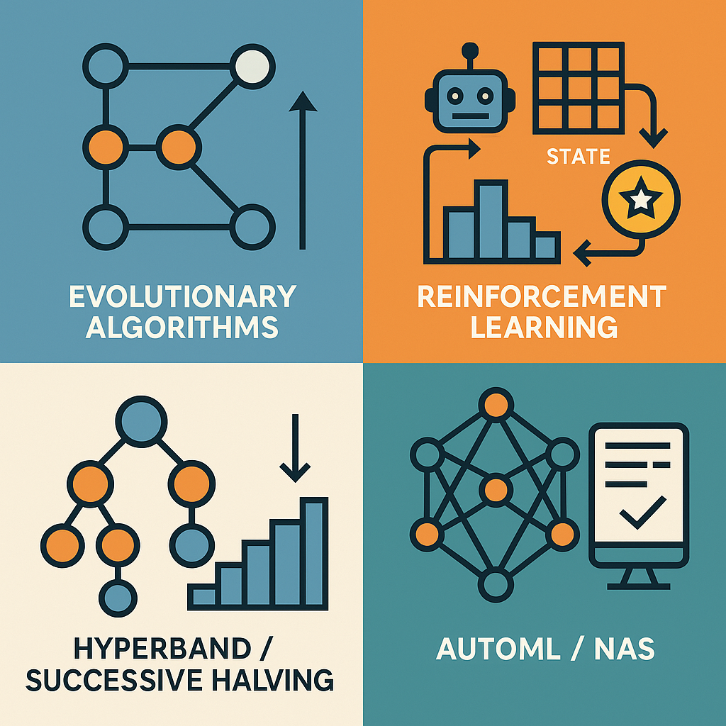
Four HPO Categories

Slide 7
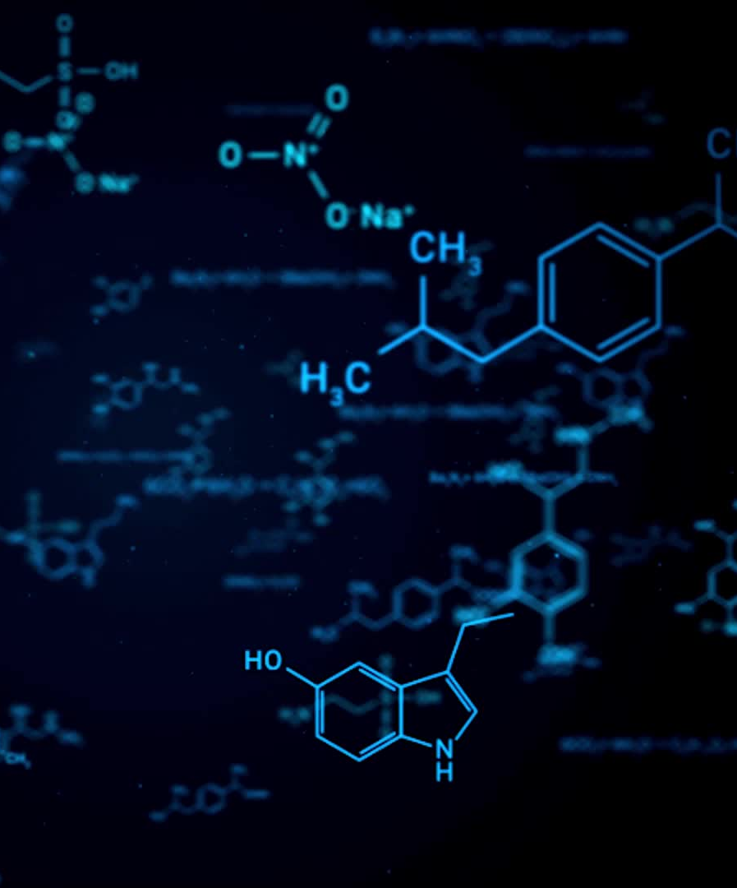
Evolutionary Algorithms (EA) Population-based search inspired by biological evolution.
Genetic Algorithms (GA)
Selection strategies (roulette, tournament)
Crossover types (single/multi-point, uniform)
Mutation strategies
Evolution Strategies (ES)
(1+1)-ES, (μ+λ)-ES, (μ,λ)-ES
Covariance Matrix Adaptation Evolution Strategy (CMA-ES)
Differential Evolution (DE)
Neuroevolution of Augmenting Topologies (NEAT)

Slide 8
Reinforcement Learning for Hyperparameter Tuning (RL) Treating HPO as a sequential decision-making process.
Q-Learning based approaches
Deep Q Networks (DQN)
Policy Gradient methods
Proximal Policy Optimization (PPO)
Multi-armed Bandits
Bayesian RL for HPO
Meta-RL / RL² for adaptive tuning strategies

Slide 9

Hyperband and Successive Halving (HB) Resource-efficient strategies that trade off budget and performance.
Basic Successive Halving (SHA)
Hyperband (bracketed SHA)
Asynchronous Successive Halving
BOHB (Bayesian Optimization + Hyperband)
Adaptively weighted Hyperband
Multi-fidelity HPO
Resource allocation strategies

Slide 10

AutoML / NAS (AM)
DARTS
ENAS, One-Shot NAS
NAS Benchmarks
NAS Evaluation Strategies
Classical AutoML Pipelines
Automated Preprocessing & Feature Engineering
Meta-Learning & Transfer Learning in AutoML

Slide 11
Libraries
Evolutionary Algorithms
- DEAP: General-purpose evolutionary algorithm framework
- Nevergrad: Facebook's optimization platform (EA, ES, DE)
- LEAP: EA/ES for PyTorch models
- Inspyred: Lightweight EA for teaching/research
- Evotorch: ES for deep RL and large models (PyTorch)
Reinforcement Learning for HPO
- Ray Tune: Scalable HPO with RL and ASHA support
- RLlib: General RL framework (extendable to HPO)
- Stable-Baselines3: Pre-built RL algorithms (DQN, PPO, etc.)
- Optuna + RL: Flexible HPO + custom RL loop
- Ax: Bandit/RL-style adaptive HPO (Meta/Facebook)
Hyperband / Successive Halving
- Optuna: Hyperband and pruning, lightweight and flexible
- Ray Tune: ASHA, Hyperband, BOHB support
- FLAML: Efficient, cost-aware AutoML/HPO
- Hyperopt: Early Hyperband support via trials
- HpBandSter: Original BOHB implementation
AutoML / NAS
- AutoSklearn: AutoML pipelines with ensembling and meta-learning
- TPOT: Genetic programming for sklearn pipelines
- H2O AutoML: Fast AutoML system for tabular data
- DARTS: Differentiable NAS for PyTorch
- NASLib: Modular research library for NAS
- AutoKeras: Keras-based NAS and AutoML tool
- Featuretools: Automated feature engineering
- AutoFeat: Lightweight feature generation and selection

Slide 12
Datasets & Evaluation
3 „real“ datasets
Data Analysis (one notebook per group per dataset)
Choose one dataset for HPO (detailed notebook)
Apply final methods to other two datasets (only note changes)
3 „synthetic“ datasets
Find best HPO method while documenting all methods
Best HPO method is tested on 4th unseen dataset

Slide 13
Real Datasets
Category | Checks
Exploration | Missing values summary, class distribution plots, feature distributions
Preprocessing Choices | Handling of NaNs, encoding of categorical vars, feature scaling justification, class imbalance
Modeling Evaluation | Use of precision/recall/F1/ROC, cross-validation, class weighting
Interpretability | Feature importances, confusion matrix, calibration
Critical Thinking | Justification of choices, discussion of limitations or flaws in data
Credit
Income
Bank

Slide 14
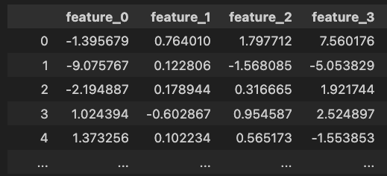
Synthetic Datasets
30.000 samples
30 features (only part of the features are relevant)
Binary classification
Difficulty increases

Slide 15
Evaluation Criteria
Final score
F1, Accuracy, etc.
Time-to-Performance
Computation time (e.g. to reach a specific score)
Budget Efficiency
Model evaluations, runtime
Robustness
Unseen data run
Reproducibility
Variance across seeds
Exploration
Different approaches
Comparisons
Documentation

Slide 16

Balance Policy – Guide Line
AutoML → A lot of Library Support (Everything needs to be explained and interpreted)
Reinforcement Learning → Custom State/reward/agent logic (at least in parts)
Evolutionary → A couple costum components (e.g. mutation, selection …)
Hyperband → Entire budget scheduling logic from scratch
Additional library usage is also strongly recommended

Slide 17

Tournament Notebook
One notebook per group
Preprocessing is done beforehand (if any)
Compares training in real-time
Best notebook (that is also good) → +0.3 to final grade
if multiple are very good, multiple +0.3 are possible
bad notebooks → -0.3
Best notebook is used for final „tournament“

Slide 18

Presentation
Presentation by topic !!! (not by group)
10 minutes presentation + 5+ minutes discussion
Content:
Very short introduction of the topic
What was the most successful approach?
What challenges did you have?
Show some results

Slide 19
Timeline
22.05. Choose your topic
05.06. Get datasets / Real start of the project
26.06. Present first results and get feedback. Also, deadline for tournament notebooks and dataset notebooks.
30.06. Deadline for final version for tournament algorithm
10.07. Final deadline for the code + Presentation
03.07. Tournament

Slide 20

Questions

Slide 21

Choose your topic

